Slide 1
Welcome to
Story Culture Live: Homegrown Storytelling as Actionable Anti-Racism Work
with Clarissa Walker
Introduce yourself in the chat
Please mute yourself and turn off your camera
If you have any technical difficulties, please message Megan Boeshart in chat or email us at events@onlinewritingcenters.org

Slide 2
Thank you!
To the presenter: Dr. Clarissa Walker
To the interpreters:

Slide 3
Participation Guidelines
Note that we are recording
Chat us if you cannot see the sign language interpreter
Keep audio off until Q&A
Post comments and questions in the chat at any time

Slide 4
How to find the chat panel in Zoom

Slide 5
Upcoming Reading Club
Discussing
Alexandria Lockett’s article, “Why I Call It the Academic Ghetto: A Critical Examination of Race, Place, and Writing Centers,” in Praxis: A Writing Center Journal.
Sept. 14th @ 3PM Eastern

Slide 6
Story Culture Live:
Homegrown Storytelling as
Actionable Anti-Racism Work
OWCA: Online Writing Center Association
Clarissa J. Walker, Ph.D

Slide 7
ORDER OF THE PRESENTATION
What is Story Culture Live?
StoryTime: Podcast Excerpt
“Porch Treasure” Framework
Activity 1: Story Spaces
Activity 2: Porch Treasure
Thank you and Invitation

Slide 8
Story Culture Live
OPERATION #1:
Framework (programming and research)
OPERATION #2:
Podcast (public and community engagement)

Slide 9
Story Culture Live
PURPOSE OF SCL:
Taxonomy of storytelling traditions/story spaces
Possibly receive help from African American elders
Ignite a renaissance of this brand of storytelling

Slide 10
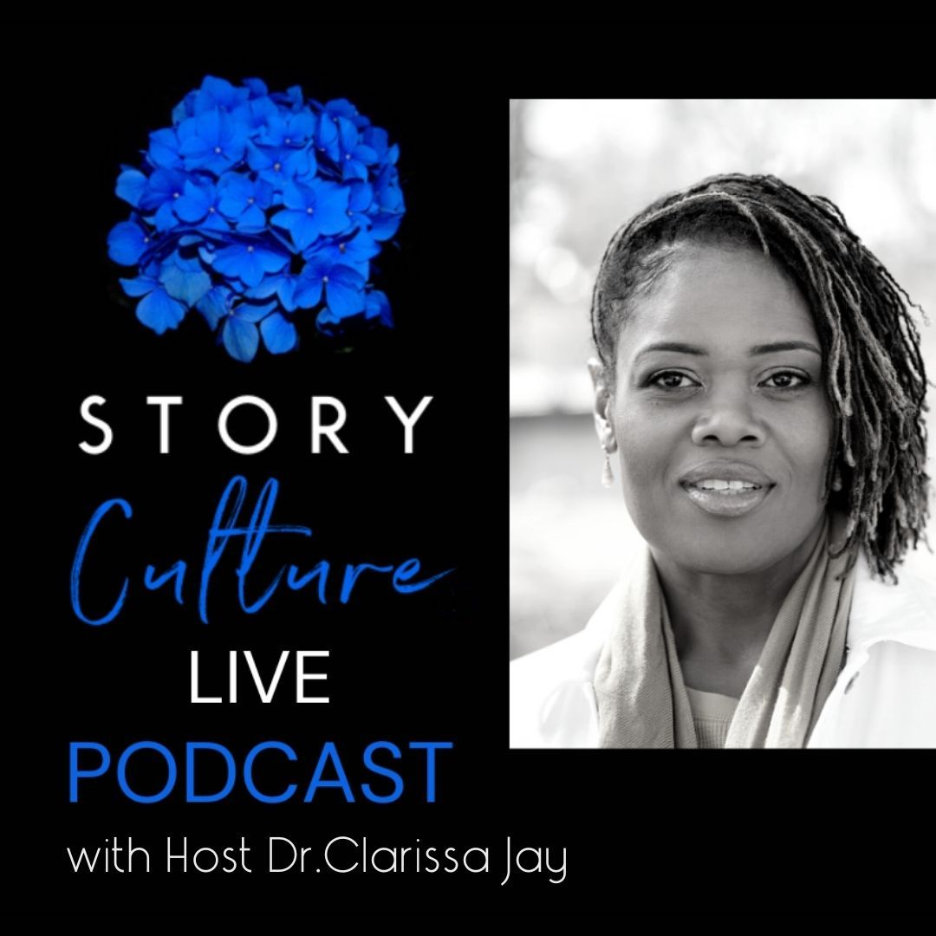
STORYTIME
Podcast Excerpt

Slide 11
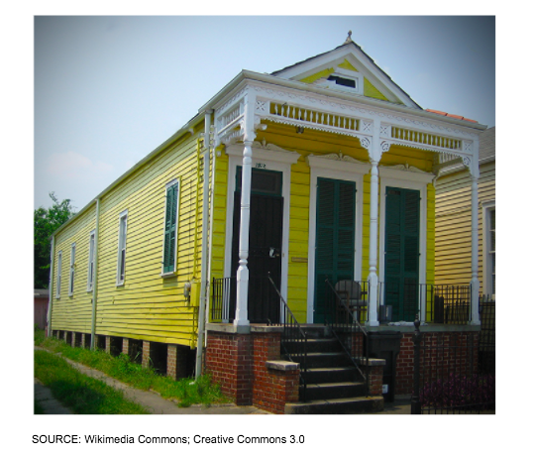
Shotgun House #1

Slide 12
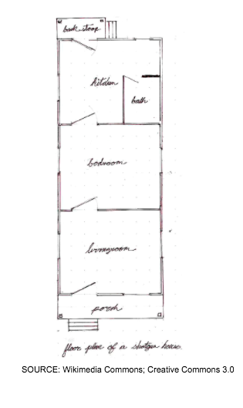
Shotgun House #2

Slide 13
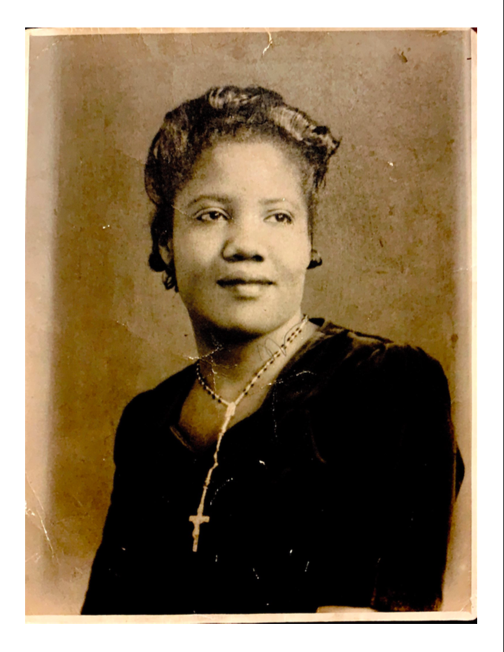
First Cousin Phoebe Wright

Slide 14
ORDER OF THE PRESENTATION
What is Story Culture Live?
StoryTime: Podcast Excerpt
“Porch Treasure” Framework
Activity 1: Story Spaces
Activity 2: Porch Treasure
Thank you and Invitation

Slide 15
“Porch Treasure” Framework
#1 Agency
#2 Kinship
#3 Tensions
#4 Identification

Slide 16
AGENCY
Phoebe, the storyteller, was the central location of power on that porch.

Slide 17
“African American women have been persistently subjected to measures of value and achievement that have been set and monitored by others, who have not had their interests or potential in mind and who have been free historically to discount, ignore, and disempower them. (Royster, 2000, p. 4)

Slide 18
KINSHIP
The deprioritization/erasure of the “white gaze” allows for a unique meaning-making space that is generative and community-specific. And, recursivity of our way of telling can be reinforcing and fortifying in this story space.

Slide 19
Toni Morrison: The Pieces I Am (2019)

Slide 20
“I didn’t want to speak for black people. I wanted to speak to and to be among. It’s us. First thing I had to do was to eliminate the white gaze.”
(Greenfield-Sanders, 00:12:41)

Slide 21
“As language and literacy researchers and educators, we acknowledge that the same anti-Black violence toward Black people in the streets across the United States mirrors the anti-Black violence that is going down in these academic streets” (Baker-Bell, Jones Stanbrough, & Everett, 2020, p. 1).

Slide 22
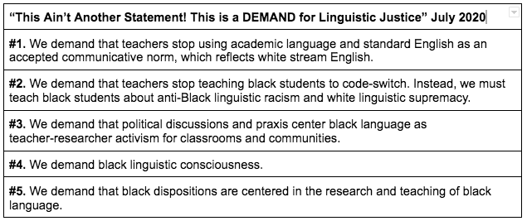
The Formal List of Demands

Slide 23
TENSIONS
This is an understanding that the violence against black bodies is forever looming over our story spaces; it’s transformative and never innocuous or dormant for African American storytellers.

Slide 24
IDENTIFICATION
In this model, identification is fostered by a shared experiential knowledge. An always deepening rapport forms that concretizes membership, a reaffirmed belonging, and a tacit agreement about “the way things are.”

Slide 25
Toni Morrison: The Pieces I Am documentary
“I know that you are assuming a white audience because you are explaining things that you don’t have to explain when you are talking to me”
(Dir. Greenfield-Sanders, 2019, 00:11:38).

Slide 26
ORDER OF THE PRESENTATION
What is Story Culture Live?
StoryTime: Podcast Excerpt
“Porch Treasure” Framework
Activity 1: Story Spaces
Activity 2: Porch Treasure
Thank you and Invitation

Slide 27
“Porch Treasure” Framework
#1 Agency
#2 Kinship
#3 Tensions
#4 Identification

Slide 28
Activity #1:
STORY SPACES

Slide 29
Activity #2:
PORCH TREASURE

Slide 30
References
Angelou, M., & Winfrey, O. (2015). I know why the caged bird sings. Random House.
Baker-Bell, A., Williams-Farrier, B., Jackson, D., Johnson, L., Kynard,C. & McMurtry, T. (2020). This Ain’t Another Statement! This is a DEMAND for Black Linguistic Justice!. College Composition and Communication. https://cccc.ncte.org/cccc/demand-for-black-linguistic-justice
Cohen, L. (2020, September 10). Police in the U.S. killed 164 black people in the first 8 months of 2020. These are their names. (Part II: May-August). CBS News.
Giebelhaus, J., Thompson, C., & Walker, T. (2019). Toni morrison : the pieces i am. Magnolia Home Entertainment.
Rahman, K. (2021, May 25). Full list of 229 black people killed by police since George Floyd's murder. Newsweek: U.S.
Royster, J. J. (1996). When the first voice you hear is not your own. College Composition and Communication, 47(1), 29–40.
Stachura, S. (2020, October 1) Remembering the Augusta Civil Rights Riot, 50 Years Later. NPR Public Radio: All Things Considered. https://www.npr.org/2020/10/01/918414307/remembering-the-augusta-civil-rights-riot-50-years-later

Slide 31
Thank you.
cwalker@ric.edu
Complete the form to stay in touch!

