Slide 1
Fostering a Research Culture in the Writing Center
Dr. Carolyn Wisniewski
Director, Writers Workshop,
University of Illinois Urbana-Champaign
cwisnie@illinois.edu
writersworkshop.illinois.edu
Notes:
Good afternoon, everyone. Like Candis and Scott, I want to begin by thanking OWCA; I’m honored to have been invited to join my colleagues on this panel. My name is Carolyn Wisniewski, and I direct our writing center, locally called the Writers Workshop, at the University of Illinois.

Slide 2
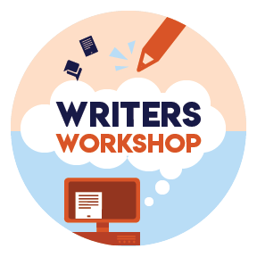
Overview
Context
Starting points
Impact
Reflection
Notes:
In what follows, I’ll provide some information about our institutional context and culture of research. I’ll tell you a bit about how I began building a culture of collaborative research when I started as a new director in 2015, and I’ll share the impact of those early undertakings. I’ll then reflect on what I know now that I wish I new as a new director, so that others can learn from some of the fumbling I’ve done along the way.

Slide 3
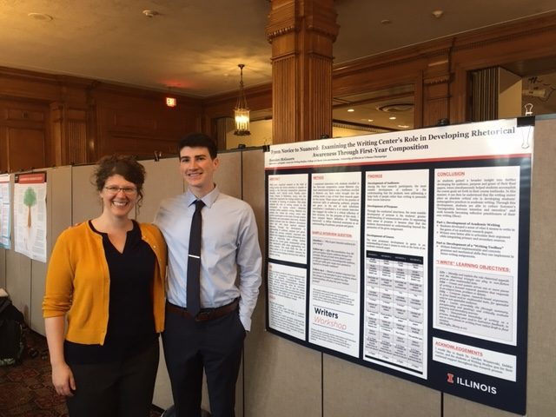
Our Context
Founded in 1990
Part of the Center for Writing Studies (CWS)
7000-7500 consultations per year
30-40 consultants
“A research university is a writing university”
Legacy of collaborative research
Notes:
The Writers Workshop was founded in 1990 as part of the Center for Writing Studies, an interdisciplinary unit housed with our College of Liberal Arts and Sciences that serves the entire campus. Our parent unit also contains a WAC program and graduate concentration.
Our writing center conducts about 7000-7500 consultations annually and employs about 30-40 consultants, usually about 2/3 of whom are graduate students and 1/3 undergraduates.
Our mission statement includes the motto (which I credit to Brad Hughes) that “A research university is a writing university.” Like Candis, we take that statement to heart both for the students and stakeholders we serve as well as for ourselves. As we explain on our website, “As part of our mission to contribute to the intellectual and creative activities of the university, the Writers Workshop engages substantially in writing center and writing studies research. This scholarly activity takes place in a variety of ways, including via undergraduate and graduate courses on writing centers and writing that I teach; via collaborative studies conducted by our administrative team; and via empirical research projects led by our current and former consultants. Across our scholarship, we seek to cultivate knowledge aimed at informing writing center theory and practice, both in our local context and through presenting our work in local, regional, national, and international conference venues.”
I was lucky to inherit a 3-credit undergraduate course that scaffolded students toward conducting a research study. However, when I stepped into this position, we had little grad involvement in research and little undergrad involvement beyond the course.

Slide 4
Getting Started
Building ethos
Fostering a collaborative community
“Bringing the writing center into the 21st century”
Notes:
When I started my position, several factors led to my decision to undertake a collaborative research study with graduate consultants.
First, I wanted to build ethos as a new director. In accepting this position, I moved from a faculty to a staff role. As we know, staff are not always accorded the same respect within research institutions as our faculty counterparts. Plus, it was important to me to keep my “research chops.” Even though research was not an official part of my job description when I began, it was important to me to keep this aspect of my professional identity alive.
Second, as a new director I had a lot of community building to do. I inherited my staff that first year, and I knew I needed to do a lot of listening to their needs but I also had to give them a reason to be excited about me and to trust me as a leader.
Finally, I was given an external evaluation that had been conducted the previous year and that charged me with bringing our writing center “into the 21st century.” When I started, students were still making phone calls to reserve appointments with us. We had a website, but no other form of online tutoring. So, I knew that an early task would be to implement an online scheduling system, and, in doing so, begin to offer online tutoring.
With these combined factors, I decided to ask consultants to volunteer to become part of a research team, where we would start a reading group about online tutoring, design a study, collect and analyze data about students’ and tutors’ experiences in our new online services, and start a process of innovation, assessment, and publication that would be key to our mission and philosophy as a writing center. Seven tutors joined my research team, the majority of whom were Writing Studies graduate students.

Slide 5
Our Process
Spring 2016
Adopted WCOnline
Decided on format (synchronous online)
Prepared IRB application
Fall 206
Assembled research team
Review scholarship
Revised study design & modified IRB
Usability testing
Spring 2017
Promoted online services
Created instructions for writers & tutors
Conducted interviews with team
Collected data Feb – May
Summer 2017
Modified tutor training guidelines for online tutoring
Data transcription
Preliminary analysis
Fall 2017
IWCA presentation
Transcription
Analysis
Spring 2019
WCJ submission
16 interviews
67 tutor logs
50 surveys
67 recorded tutorials
Notes:
I want to give you a short snapshot of our process, which lasted from Spring 2016 to about Spring 2019, and, if we include follow-up research, continues today.
Our process had a lot of steps: We had to determine our online format and tools, test them ourselves, and prepare the infrastructure to go live with our writers. We had to design the study, which included drafting interview scripts and surveys and involved more than one modification of the IRB protocol. We spent a semester collecting data, and then spent more than one semester transcribing and analyzing that data. We took our results to IWCA twice, and we published an article in The Writing Center Journal.

Slide 6
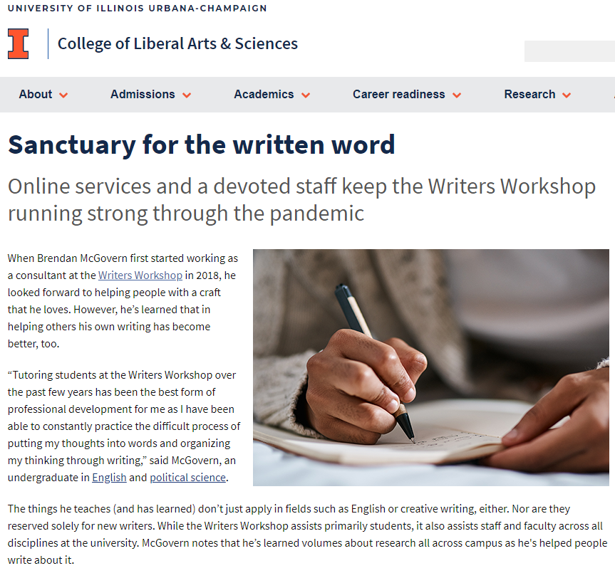
Impact
Scholarship and professional development
Center culture
Practice and implementation
Buy-in
Notes:
This collaborative research had a range of positive impacts for our center.
The research team had opportunities for scholarly and professional development, including conference attendance and publication. Three members of this research team are now writing center directors themselves.
Our collaborative research also fostered community and made self-study and assessment central to the identity of our center.
Our research increased staff buy-in for online tutoring. We learned about what made sessions successful and satisfactory to tutors and writers, were able to implement practical suggestions to refine our services, and created robust training and preparatory experiences. Online tutoring, which had been new, became a normal part of all our tutors’ practice, and we were therefore prepared to pivot seamlessly to fully online tutoring during the COVID pandemic.
Our research also raised visibility of our writing center. Like Candis and Scott have mentioned, we created a “Research” page on our website. We were invited to present about our collaboration to graduate students and faculty in the Center for Writing Studies. Our work and its impact on practice was featured in a College of Liberal Arts and Sciences newsletter.
As well, other undergraduate and graduate students have collaborated with me to pick up where the original study left off, asking questions about online tutoring during the pandemic and now in our current state. We developed asynchronous tutoring with a similar process and are currently analyzing tutors’ and students’ experiences across multiple modes. In other words, this research had “legs,” so to speak, and carried our center into a range of new directions.

Slide 7
If I knew then…
Be prepared for a lengthy process
Write an expansive IRB for less yearly maintenance & revision
Define team member roles
Determine data management procedures
Notes:
Before I conclude, I want to share some reflections on what I’ve learned about collaborative research.
First, as you saw, this collaboration spanned not just months but years. I’d been prepared for a lengthy collaboration, but I think both my co-researchers and I were unprepared for just how long the process took from initial IRB protocol to eventual publication. So, if you’re on a timeline, be ruthless about your research question and the amount of data you plan to collect. If you’re a new researcher working with novice researchers, consider starting with a replication study. Such an approach can place useful constraints on a study, with a defined research question, body of literature, and methods to use.
Second, I recommend writing an expansive IRB. Here, I’m thinking along two lines. First, our research team kept thinking of additional data points we wanted to collect, and so we had to submit a modified protocol each time. So, plan, plan, plan. Second, I recommend talking with your IRB about whether you might be able to create an expansive protocol that could cover more than one project at your center. I’ve done this to cover our undergraduate research, and it cuts down a lot of the paperwork I have to do each year.
Third, if you have a relatively large research team than ours—more than 2-3 people involved—define team members’ roles. While we aimed to be collaborative throughout, we found that not everyone was able to stay on the same timeline for transcription, data analysis, and writing. Now, I try to be more purposeful about which team members might only be involved in data collection vs. analysis vs. writing. Having a conversation about those roles up front can prevent confusion later.
Finally, be really purposeful about your data management strategies. We collected a ton of data for this study, and did so at a time when I was still new to my university. I wasn’t fully aware of data storage options or even of how detailed our data management plan needed to be (even down to guidelines for naming files). Also, we had 83 files to transcribe. I talked to our university’s data folks, who led us down a rabbit hole of ineffective (at the time) voice-to-text. Let’s be thankful that technology has improved enormously over the last few years.
I’m happy to share other lessons learned during our Q & A.

Slide 8
Thanks to my co-researchers!
Tom Carreras, María Paz Carvajal Regidor, Lisa Chason, Evin Groundwater, Allison Kranek, Dorothy Mayne, Logan Middleton
Notes:
Before I sign off, I want to thank my co-researchers, Tom Carreras, María Paz Carvajal Regidor, Lisa Chason, Evin Groundwater, Allison Kranek, Dorothy Mayne, Logan Middleton. They have been amazing to work with, and I’m so glad to have collaborated with them. I also want to take a minute to acknowledge our field, which has such a longstanding history of valuing and publishing collaborative research and of making space institutionally and professionally to welcome newcomers to writing center research.

