Slide 1
Integrating Gesticulation as a Physical multimodal approach in Online Writing Consultations
Notes:
To change the image on this slide, select the picture and delete it. Then click the Pictures icon in the placeholder to insert your own image.

Slide 2
CONSIDERATIONS
what is the role of bodily modalities (for instance, gesticulations) in creating meaning and fostering understanding in online consultations?
How can bodily modality be better integrated into online writing consultations in ways that make meaning more accessible?
How might visual, spatial, linguistics, audio/video recordings and other technologically mediated modes of communication be harnessed efficiently to fit into online writing consultations?

Slide 3
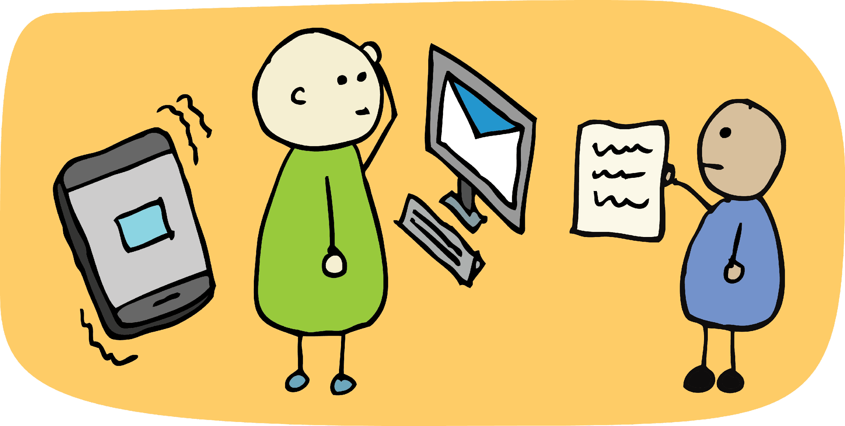
Technology & Online consultations Technology cuts across the different forms of communication we use; whether written, audio, or video formats. Considering the physical distance created during online writing consultations, how we inculcate multimodal strategies in the technologically mediated environment without causing disruptions to recipients' understanding is critical.

Slide 4
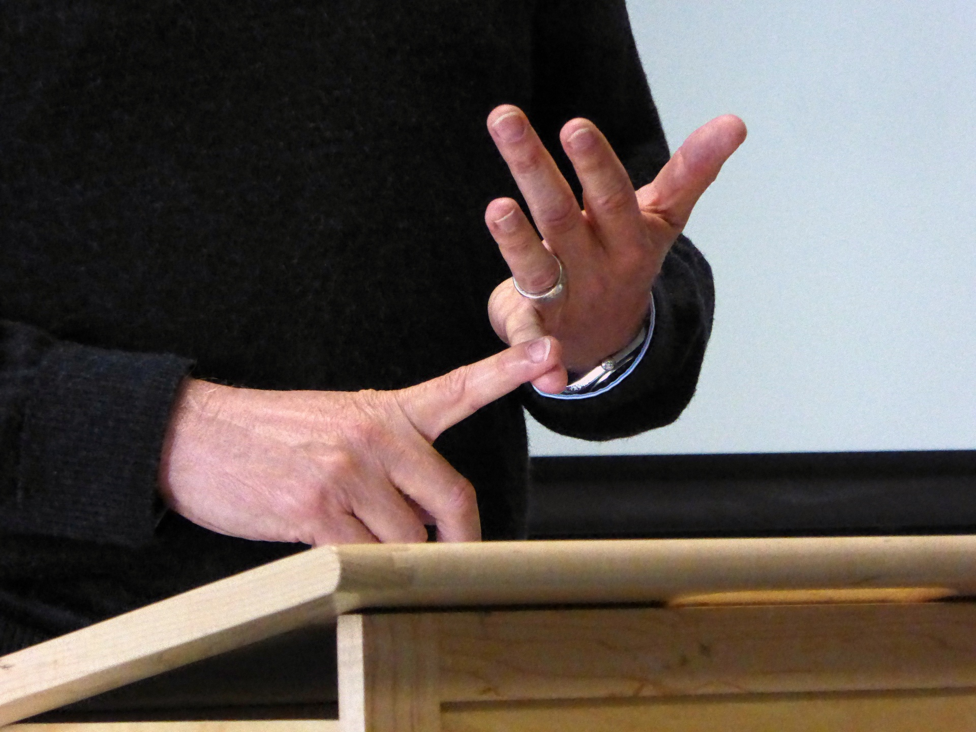
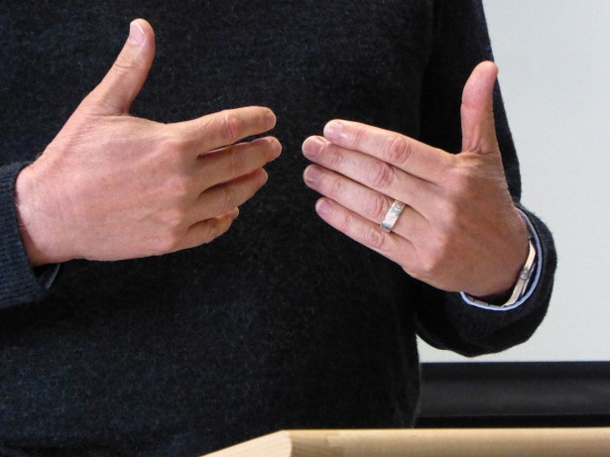
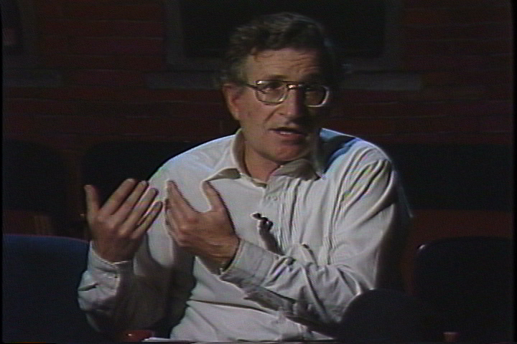
How can we harness the potentials of Multimodal communication through Gesticulation? The interactions during an online writing consultation involve a multiplicity of communicative styles from verbal to visual and even kinesthetic approaches which make it necessary to accommodate students learning idiosyncrasies (Fitzgerald & Ianetta, 2016). Based on the above, how can we harness the potential that multimodality promises when through gesticulations in providing feedback during an online writing consultation in a cohesive and inclusive manner bearing in mind the technological limitation of non-human connection during online writing consultations?

Slide 5
Findings on this study showed that excessive gesticulations during cwriting consultation feedback can disrupt the flow of communication during online consulting bearing in mind differences in non verbal cue processing. Face to face contact reduces the strain imposed on the student interpreting the feedback unlike the digitally enhanced online consultation. As such, gesticulations can be inculcated in to feedback in cases where both consultant and student understand non verbal cues and gesticulations used in the course of an online consultation
Findings

Slide 6
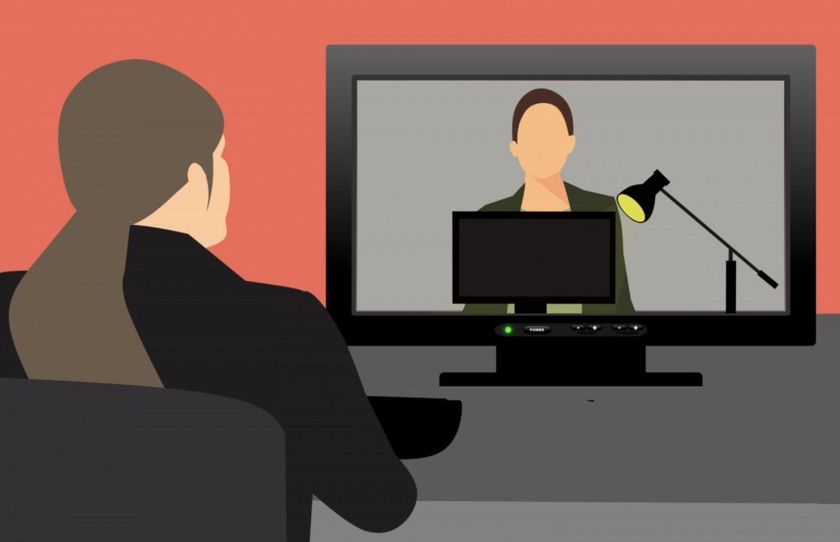
Conclusion
Considering the evolving communicative needs in a globalized world, effectively integrating bodily modalities such as gesticulations into online writing consultations will make online writing consultations more engaging for students irrespective of communication orientations, background or learning differences.

Slide 7
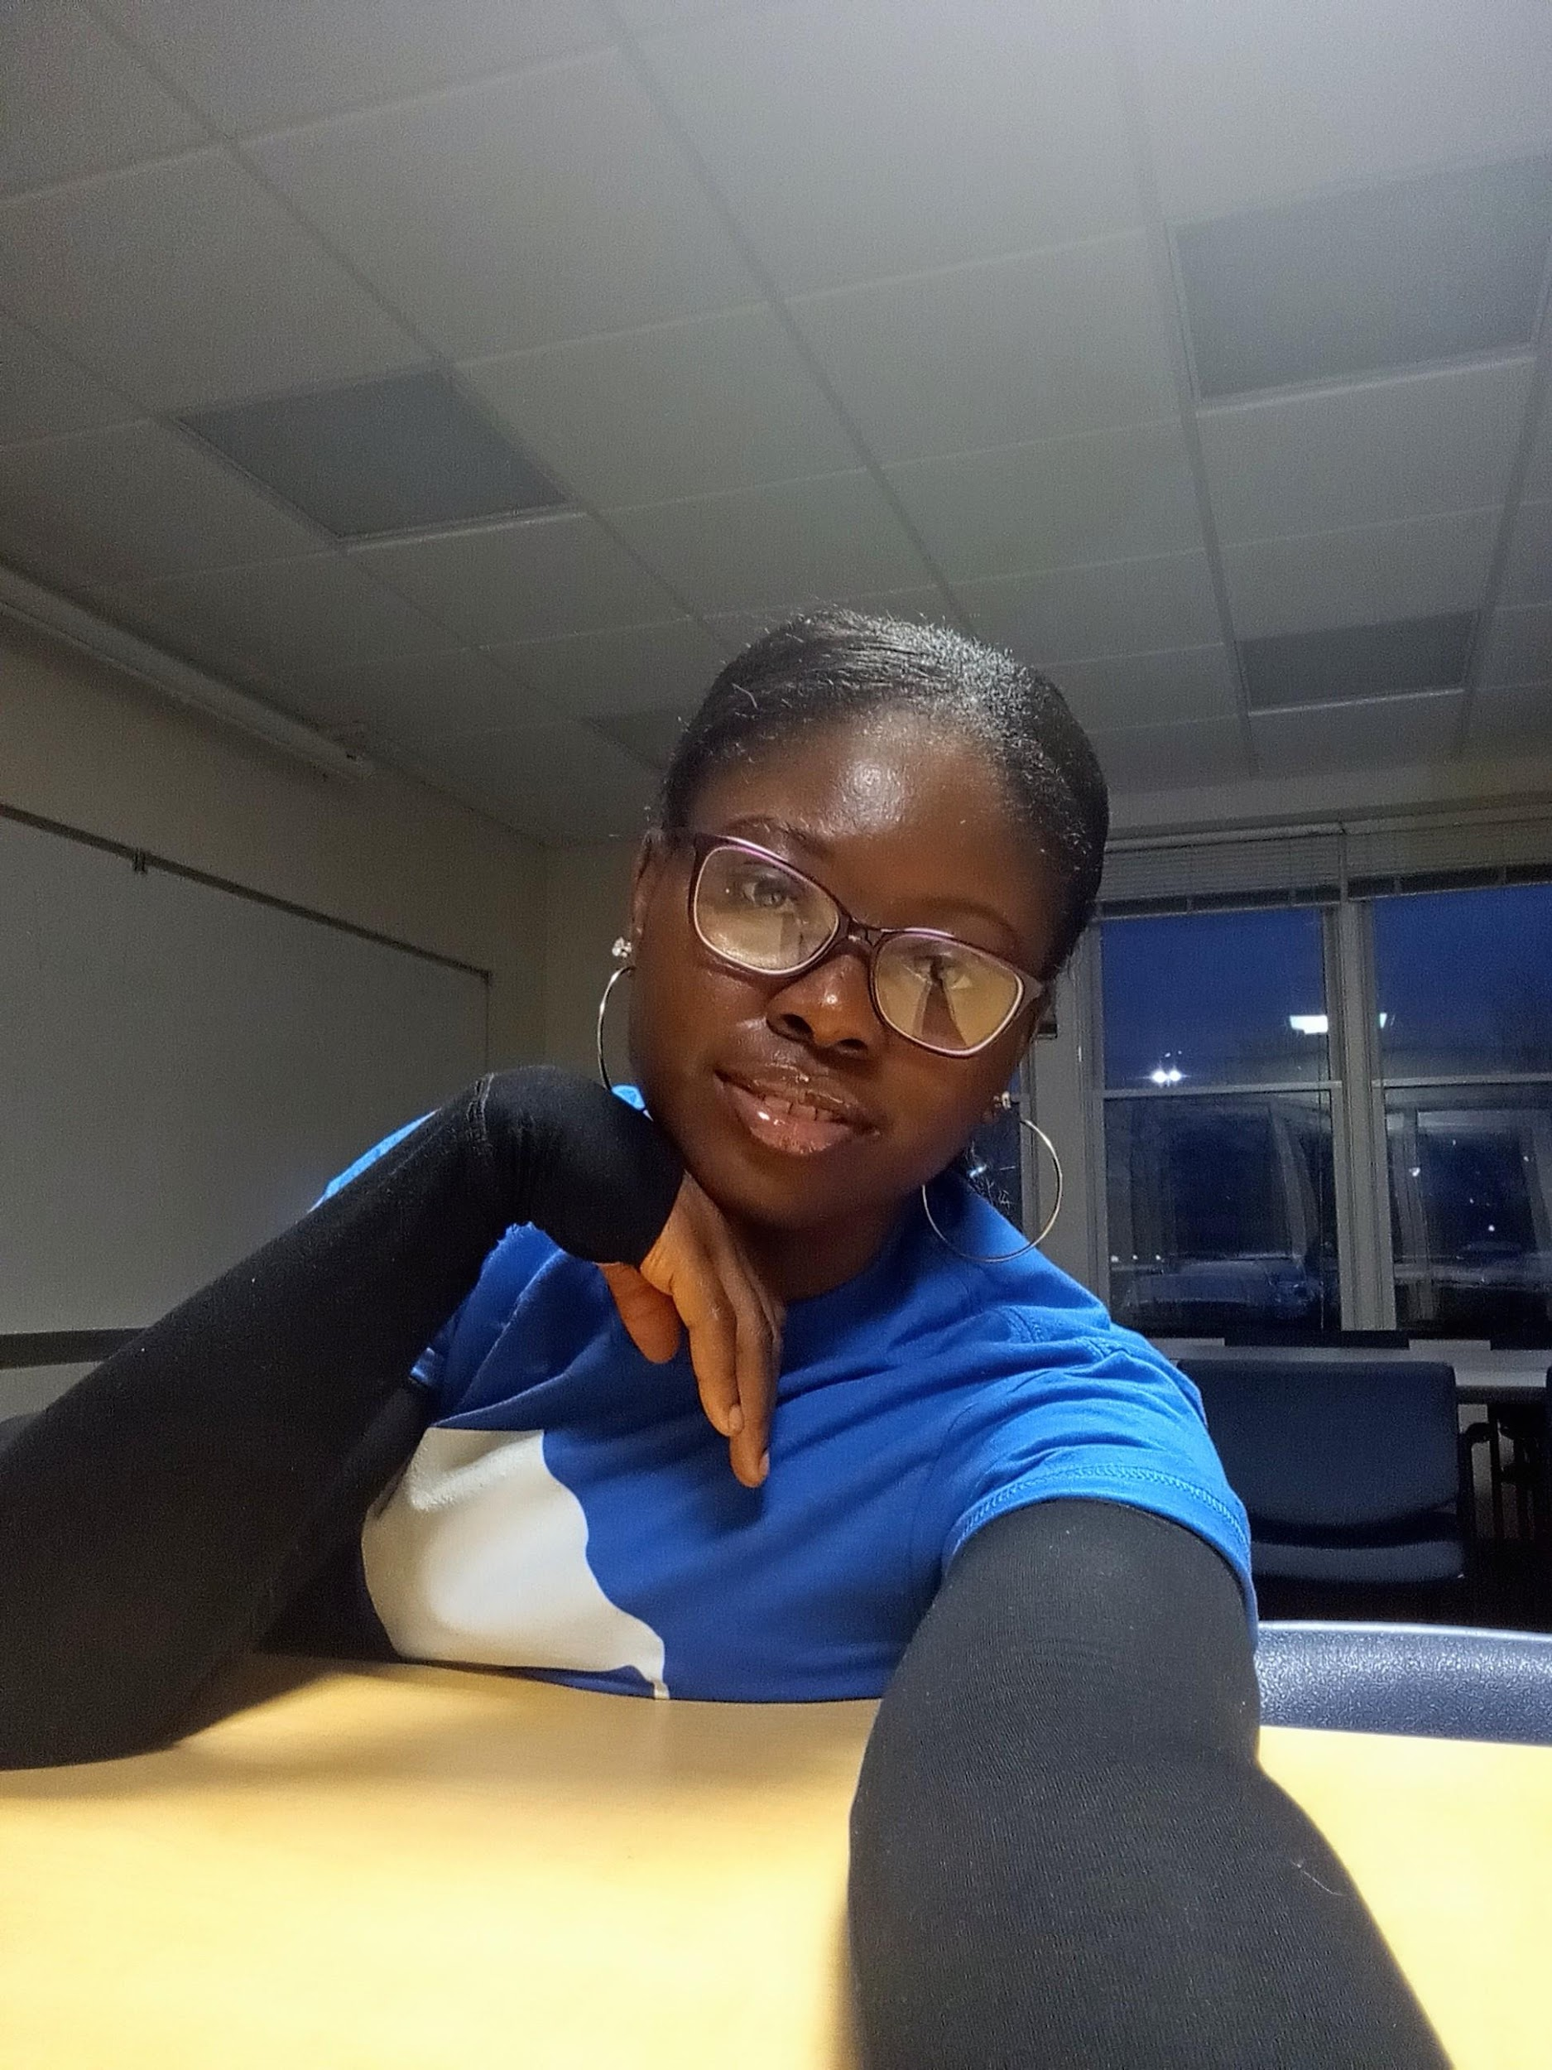
Presented by: Christiana Unakalamba Graduate Writing Consultant, Grand Valley State University Fred Meijer Writing Center.

