Slide 1
Inclusive Response Practices Key Findings from a Mixed Methods Study of Asynchronous Feedback Uptake
Laura Hardin Marshall, Ph.D.
Perspectives on Asynchronous Tutoring
Online Writing Centers Association
Webinar Series, May 2023

Slide 2
Mixed Methods Study
Site: Saint Louis University
Context: required first-year composition course (ENGL 1900)
Collected students’ rough drafts (with comments) and final drafts
Surveyed teachers and writing consultants about their pedagogical training

Slide 3
What comments or whose comments prompt revision?

Slide 4
Teachers and Consultants

Slide 5
Instructors
Classroom pedagogy experience or training only
Teachers and Consultants
(usually faculty)

Slide 6
Instructors
Classroom pedagogy experience or training only
Consultants
Writing center pedagogy training or experience only
Teachers and Consultants
(usually faculty)
(usually undergraduate students)

Slide 7
Instructors
Classroom pedagogy experience or training only
Consultants
Writing center pedagogy training or experience only
Teachers and Consultants
(usually faculty)
(usually undergraduate students)
Cross-Trained
Training or experience in BOTH
(usually graduate students)

Slide 8
Comment Analysis
Other Themes
Disarming
Prominent Themes
Affirming
Investigating
Telling
Suggesting
Session Setting
Minimal Marking (under Suggesting)

Slide 9
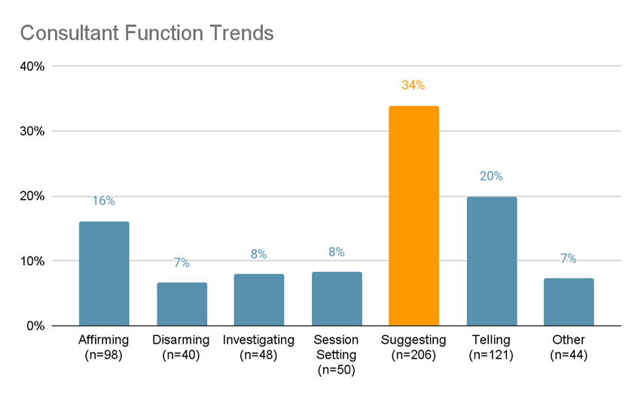

Slide 10
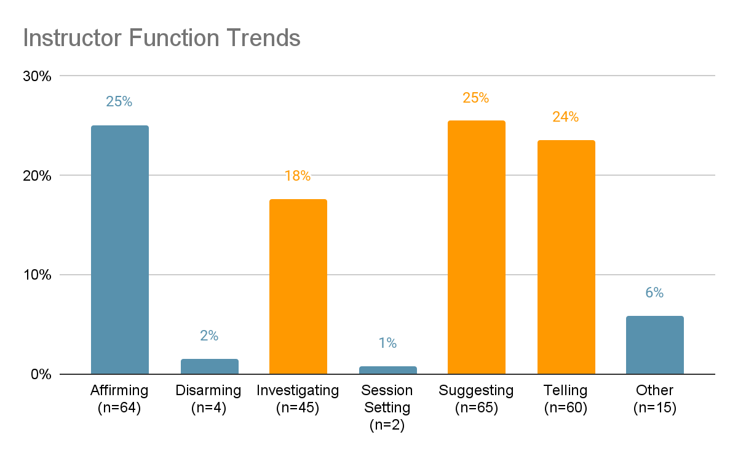
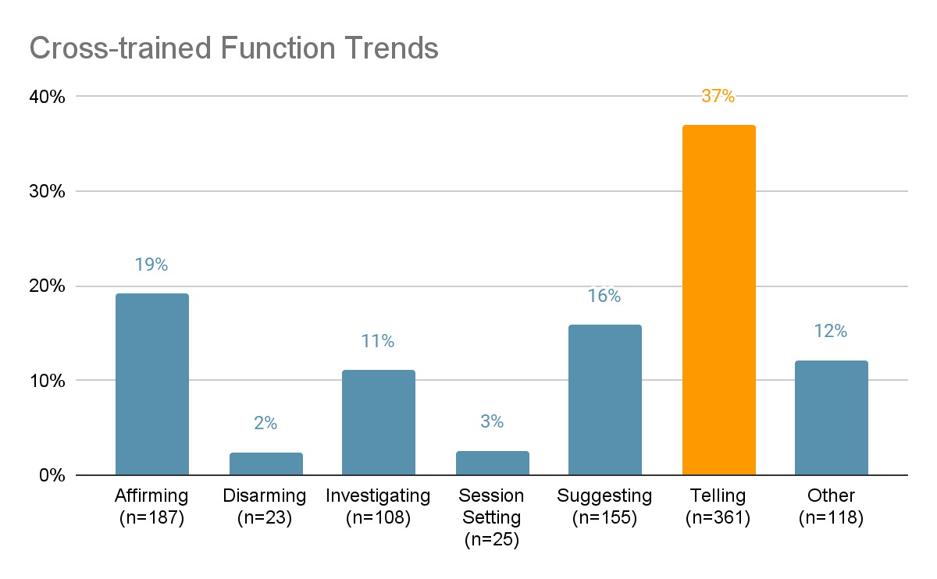
Minimal use of disarming or session setting

Slide 11
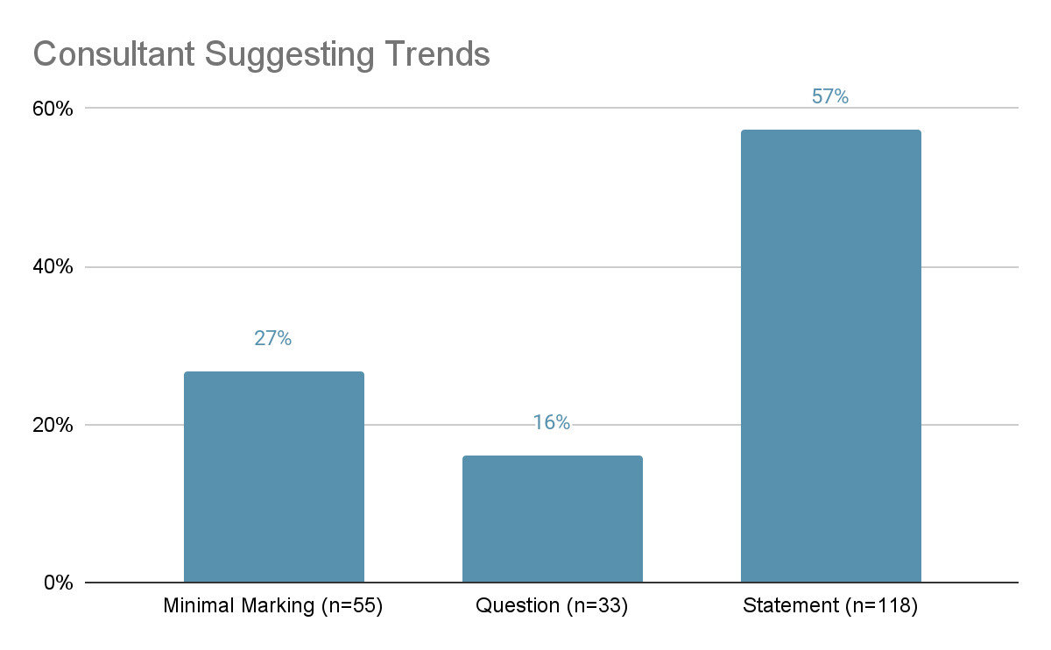

Slide 12
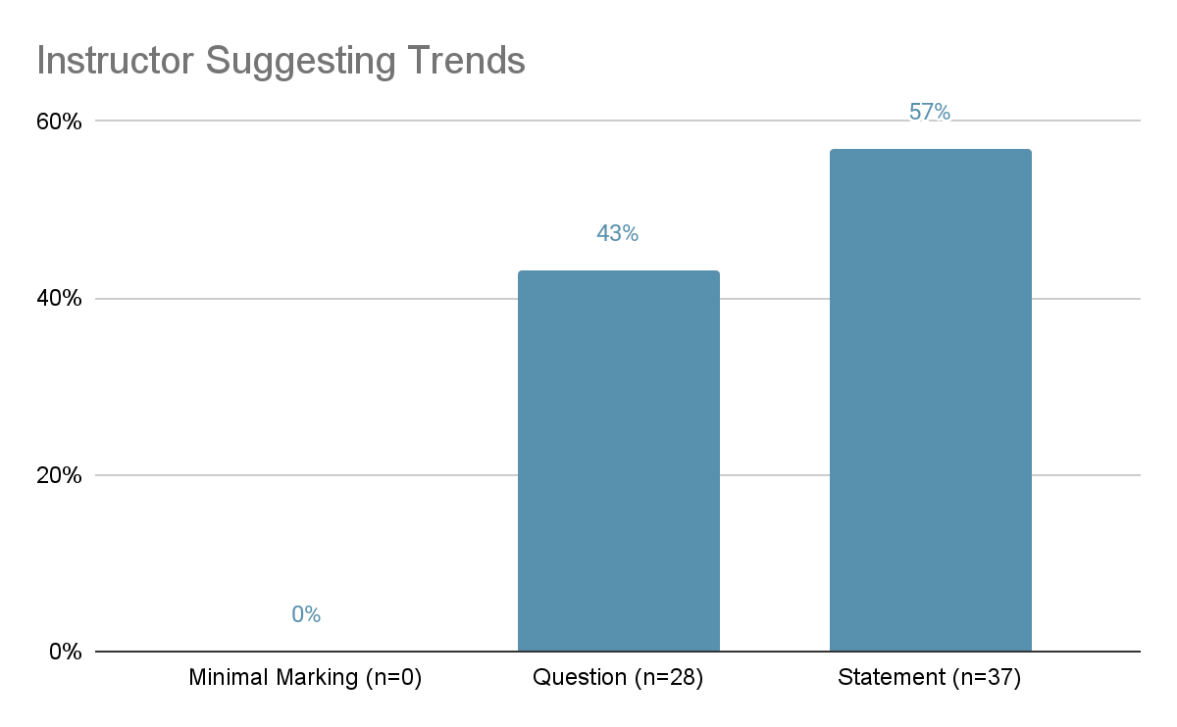
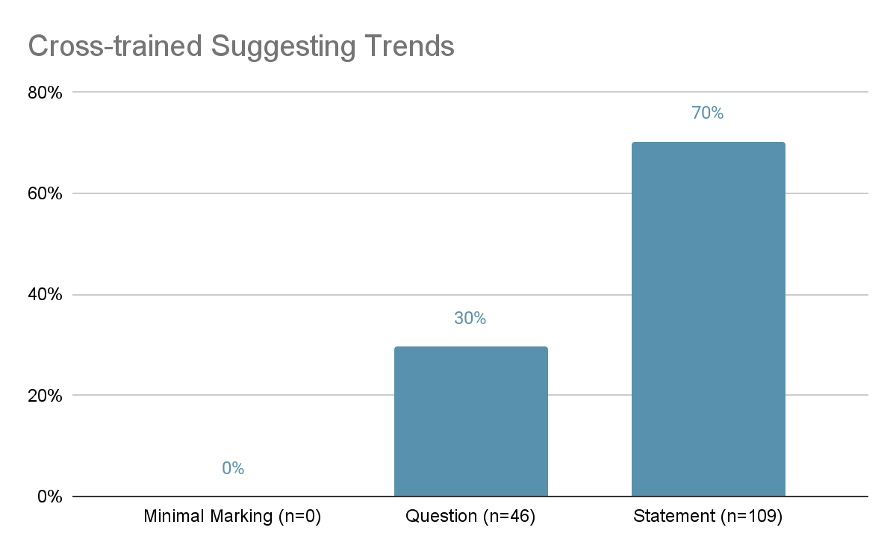
No use of minimal marking

Slide 13
Inclusion and Access
Transparency and guidance about asynchronous feedback
Assist writers in processing the feedback and potential next steps
Potentially assist writers in acting on feedback

Slide 14
Revision Findings
Revision
Attempt (some relevant change)
Avoidance
Indeterminate
No Attempt (no relevant change)
Not Applicable (excluded)

Slide 15
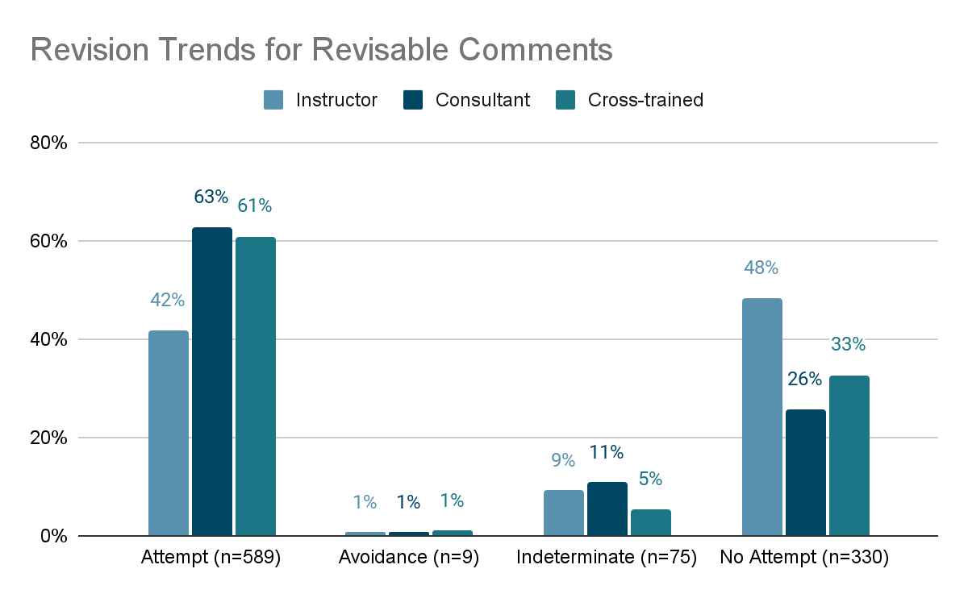
Instructors: 42% attempt vs 48% no attempt

Slide 16
Consultants and cross-trained

Slide 17
Subthemes
Suggesting
Minimal marking
Telling
Editing
Questions
Statements
Explicit
Implicit

Slide 18
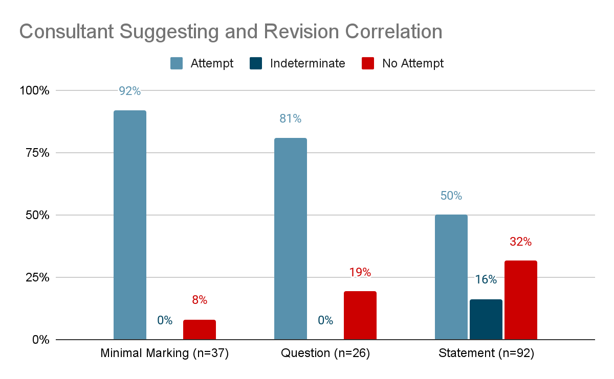

Slide 19
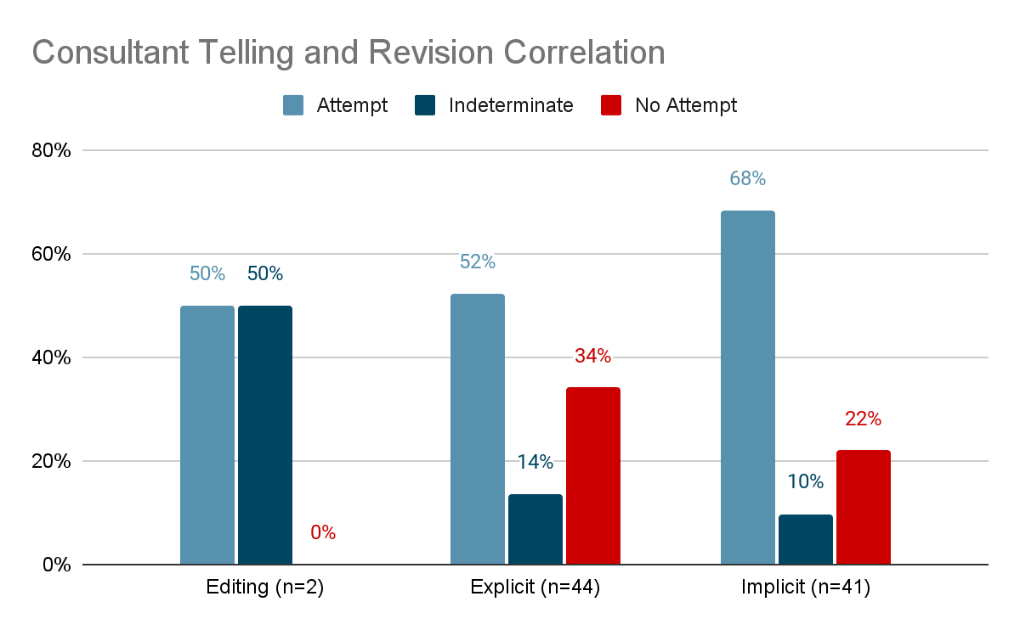

Slide 20
Consultants’ Successes
Minimal Marking (Suggesting) – 92%
Questions (Suggesting) – 81%
Implicit (Telling) – 68%

Slide 21
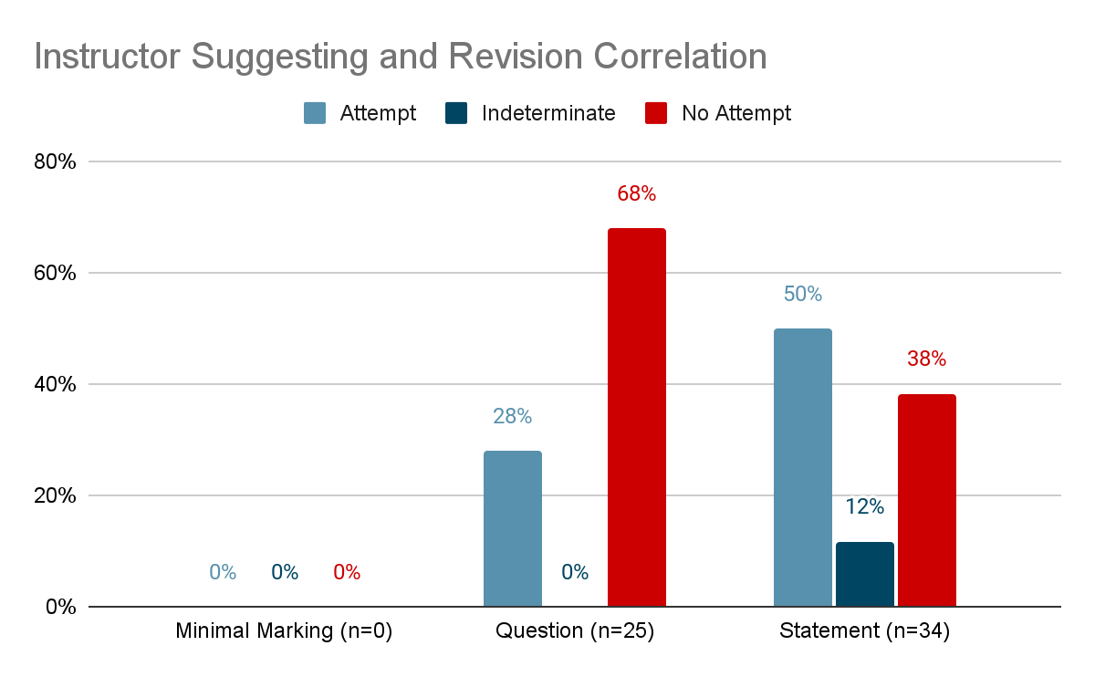
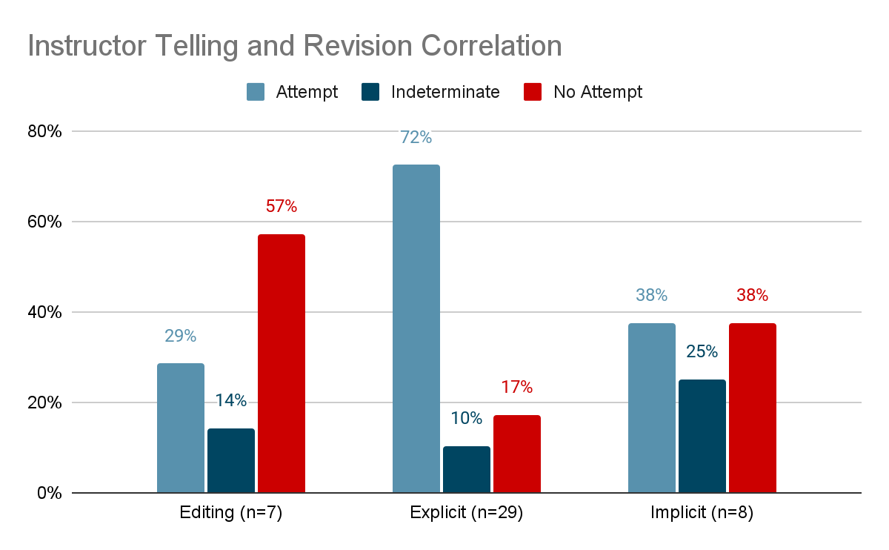
Instructors’ Trends
Questions 68% unattempted
Explicit telling 72% attempted

Slide 22
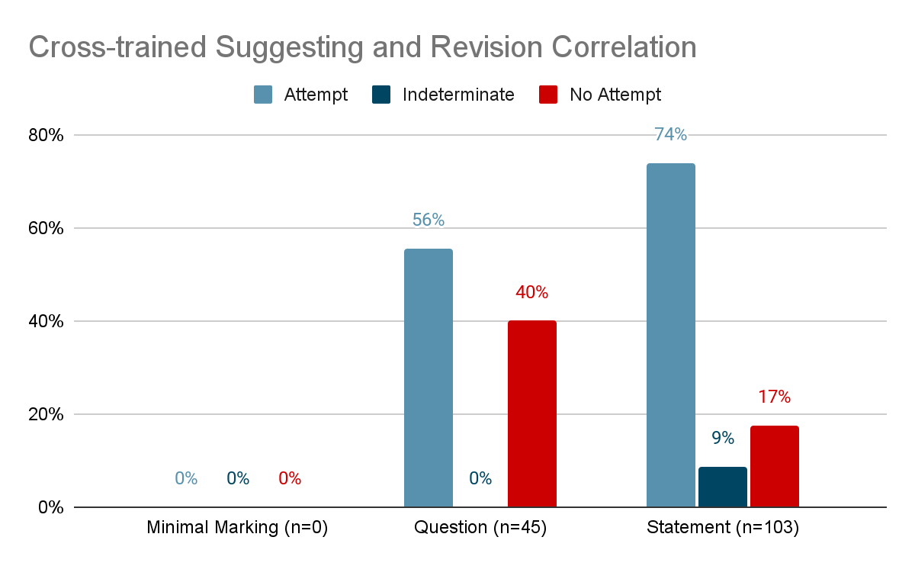
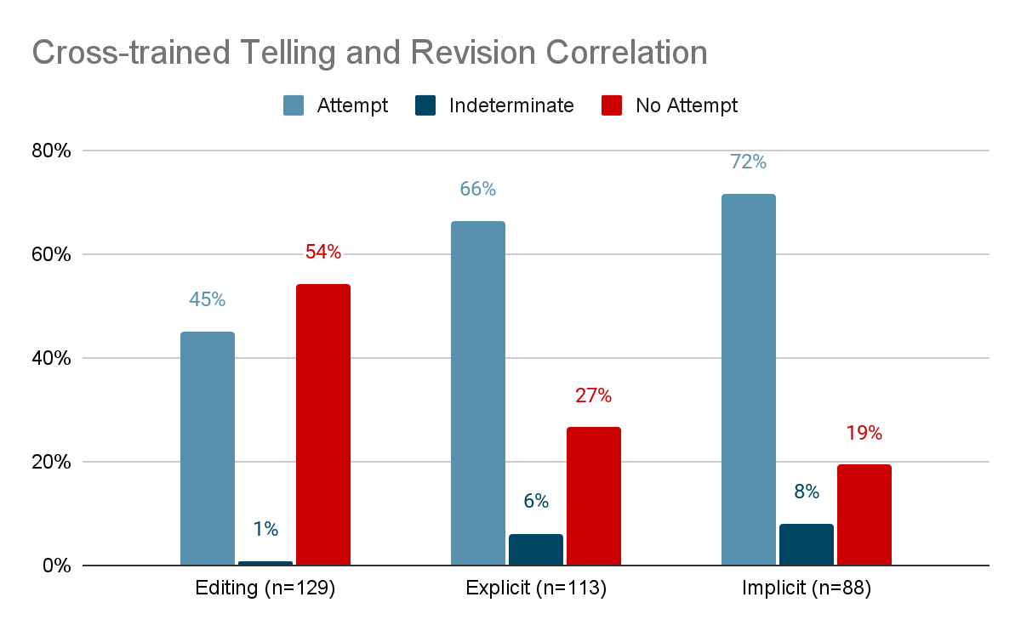
Cross-trained Teachers’ Trends
Suggesting statements 74% attempted
Explicit and implicit telling both successful

Slide 23
What was going on there?

Slide 24
Inclusive Response Practices
Making Connections
Explaining processes
Offering a Strategy

